Slide 1
Time Series To infinity and beyond…. by Ralf Martin (r.martin@imperial.ac.uk)

Slide 2
Objectives of this lecture
Time Series data: Different data points represent different points in time
This introduces some additional challenges
We will discuss how to deal with those

Slide 3

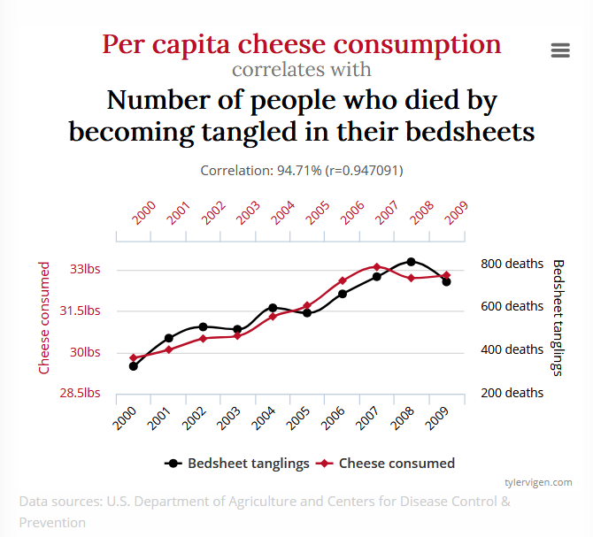
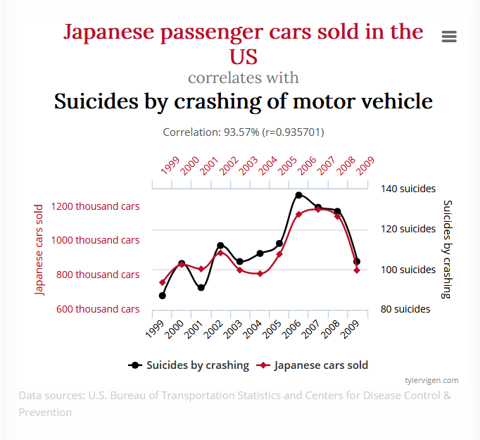
What’s the challenge of time series data?
Can you spot the problem?
Time becomes a confounding variable
Non-stationary: characteristics of data vary with time

Slide 4

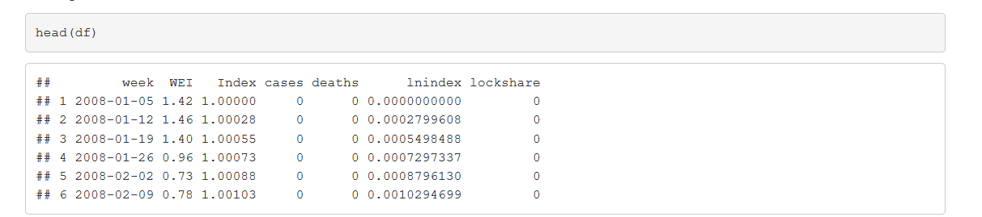
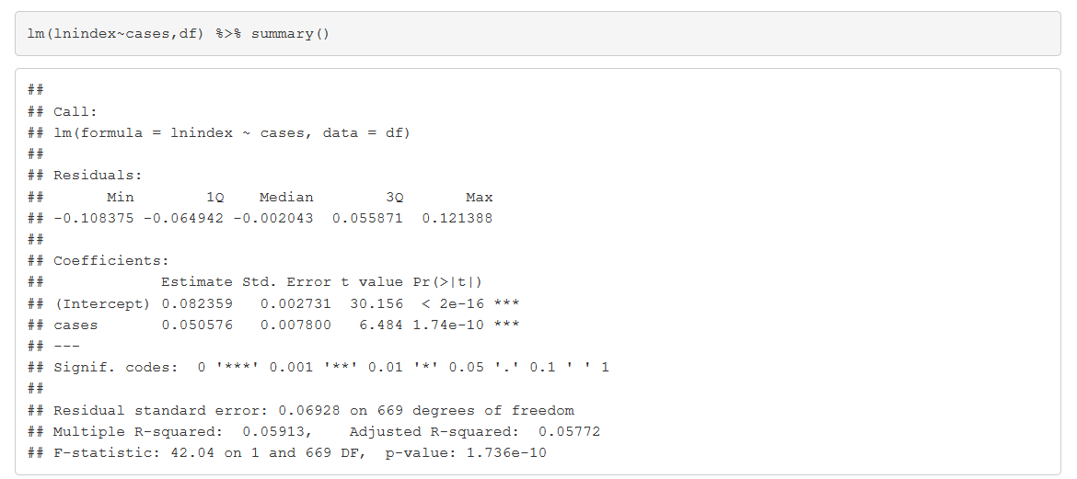
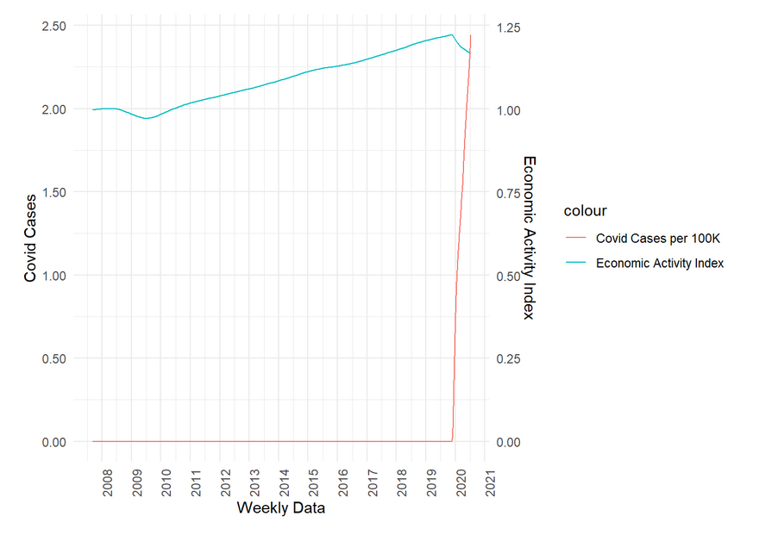
COVID vs GDP
What you think is going to happen?
More COVID = more GDP?
100K more = 5% more GDP?
In 100K of cases

Slide 5
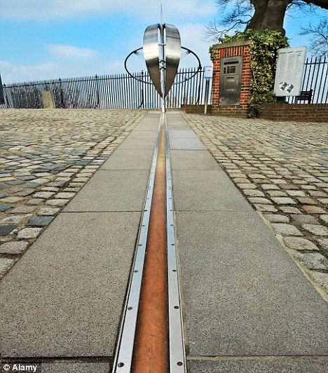
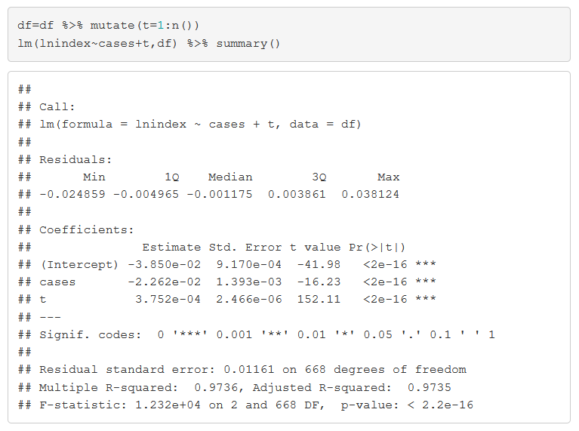
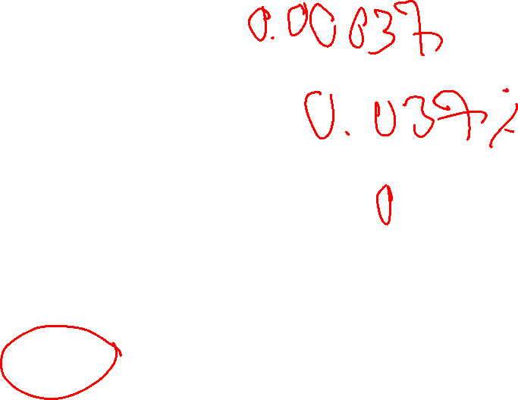
Taking control of time….with a timeline
100k more cases = 2.26% lower GDP

Slide 6
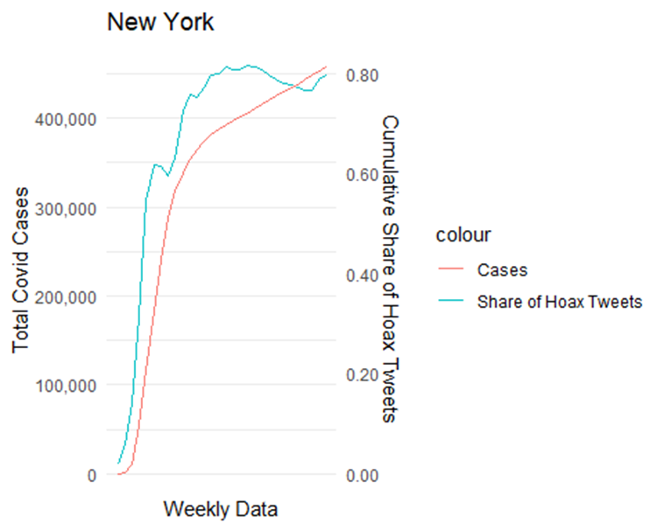
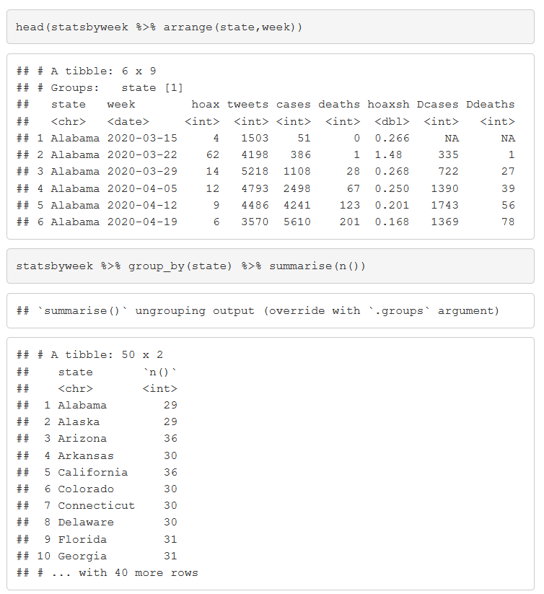
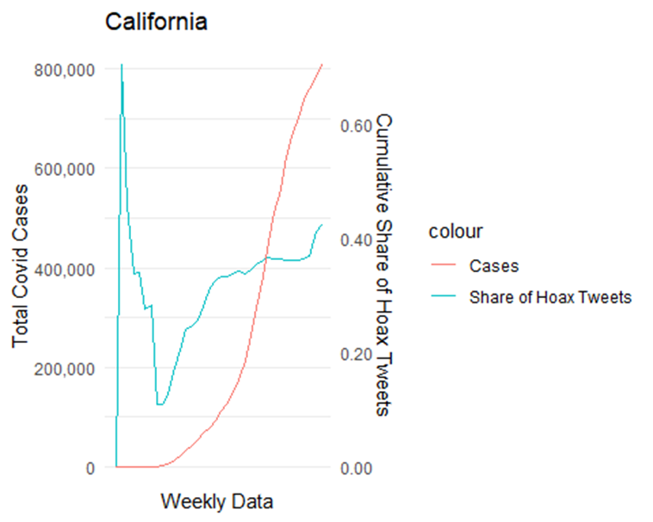
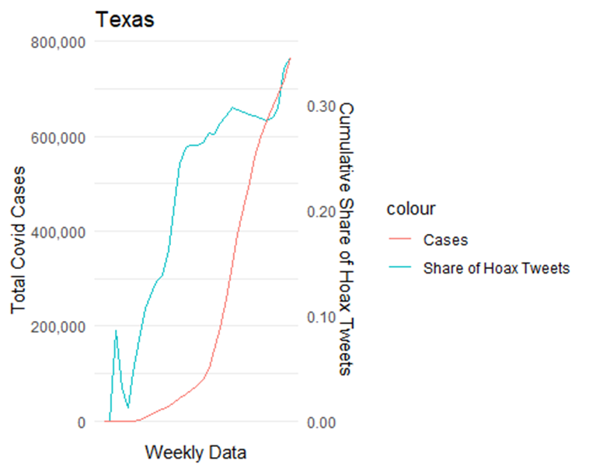
What if time is not linear?
Seasonal effects
Recessions
Natural disasters
Political turmoil
War
Pandemic
Panel data to the rescue
Multiple periods for the same cross section unit

Slide 7
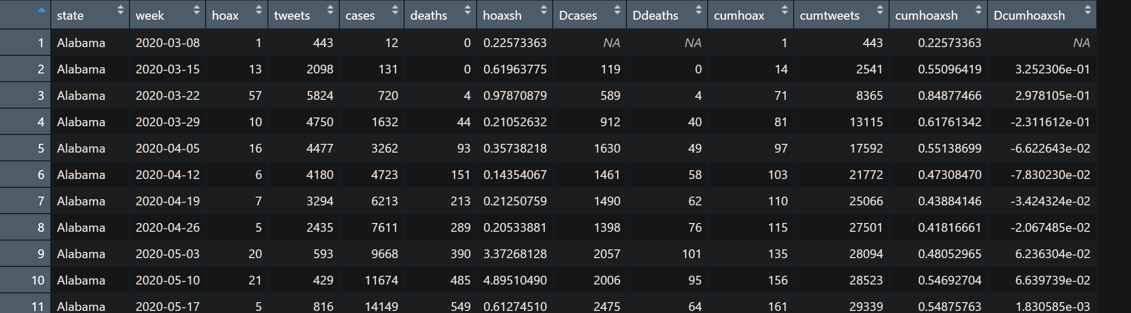
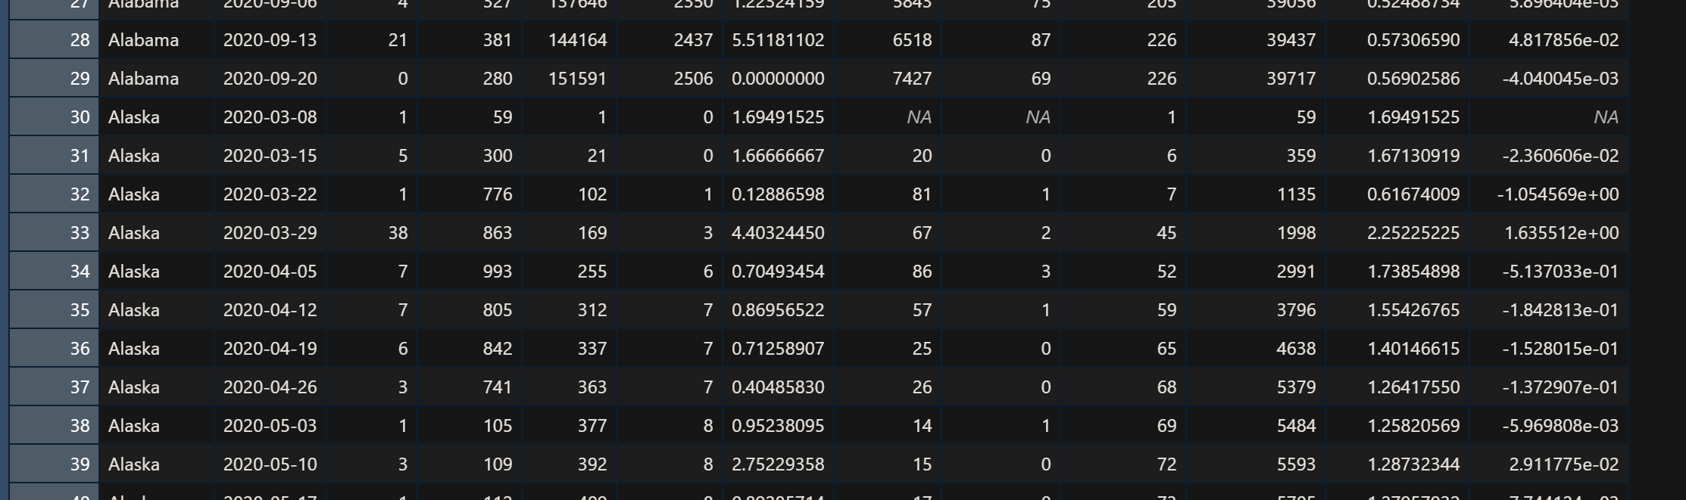
Panel data

Slide 8
Panel data example
lm(cases~cumhoaxsh+factor(state)+factor(week),statsbyweek) %>% summary()
## ## Call: ## lm(formula = cases ~ cumhoaxsh + factor(state) + factor(week), ## data = statsbyweek) ## ## Residuals: ## Min 1Q Median 3Q Max ## -244737 -21562 1446 21041 463246 ## ## Coefficients: ## Estimate Std. Error t value Pr(>|t|) ## (Intercept) -109303 41227 -2.651 0.008107 ** ## cumhoaxsh 61619 19128 3.221 0.001304 ** ## factor(state)Alaska -96560 22677 -4.258 2.20e-05 *** ## factor(state)Arizona 34689 16951 2.046 0.040899 * ## factor(state)Arkansas -9094 18337 -0.496 0.620015 ## factor(state)California 224047 17120 13.087 < 2e-16 *** ## factor(state)Colorado -8425 17692 -0.476 0.634008 ## factor(state)Connecticut 4626 18572 0.249 0.803343 ## factor(state)Delaware -31191 17875 -1.745 0.081207 . ## factor(state)Florida 206617 17752 11.639 < 2e-16 ***
Hoax share up by 1 percentage point means 121120 more cases
Also controlling for state
Smaller effect when controlling for time (week) effects
e.g.: more rural and less densely populated states have also less people engaged in hoax conspiracies
Example issue: suppose in some weeks there are school holidays (and hence a lower number of covid cases). Also suppose that hoax tweeters are more active over the holidays

Slide 9
Time and cross sectional unit as co-founder
COVID Cases
Hoax Share
Events in a particular week
COVID Cases
Hoax Share
Characteristics of particular state
We include dummy for every state and every year
Also known as fixed effects

Slide 10
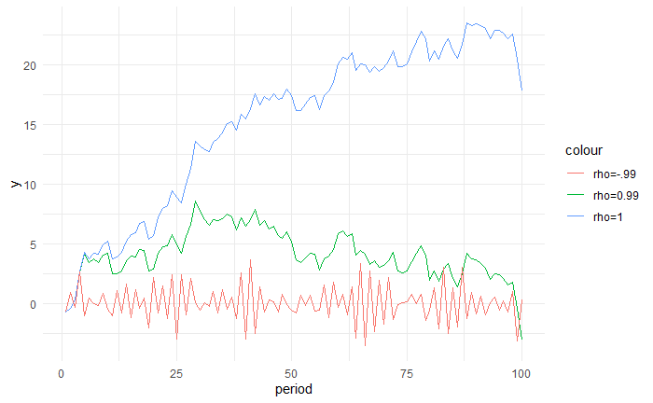

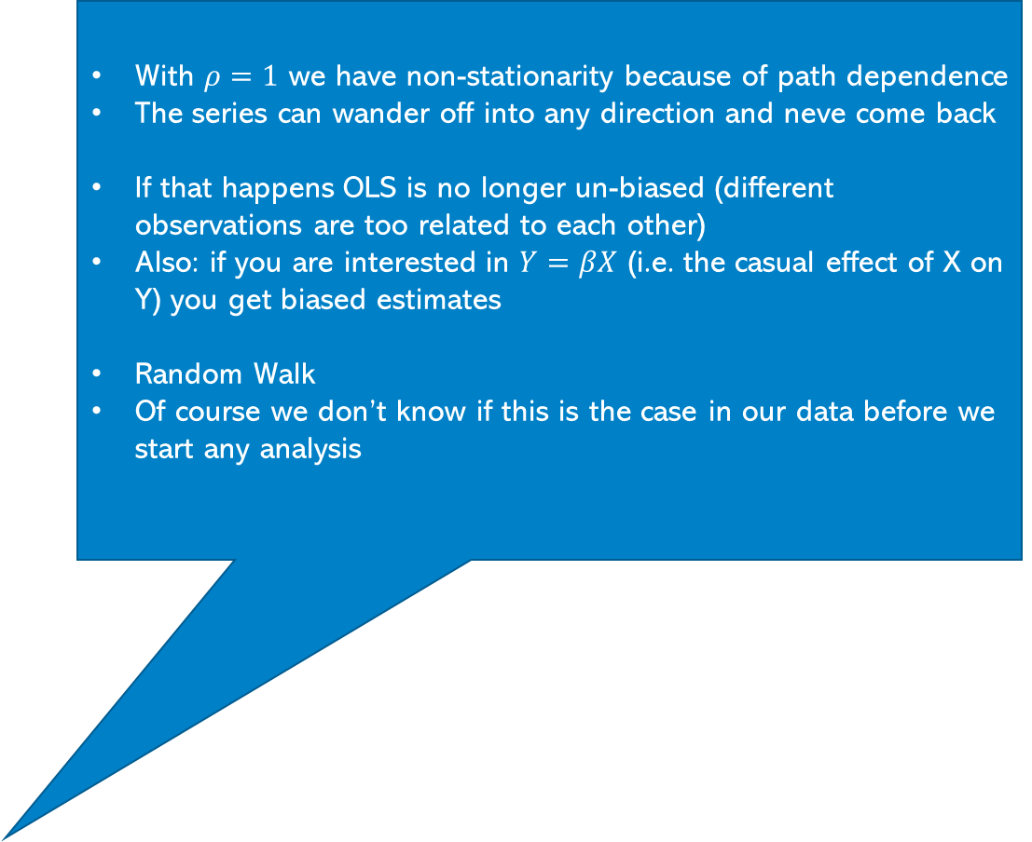

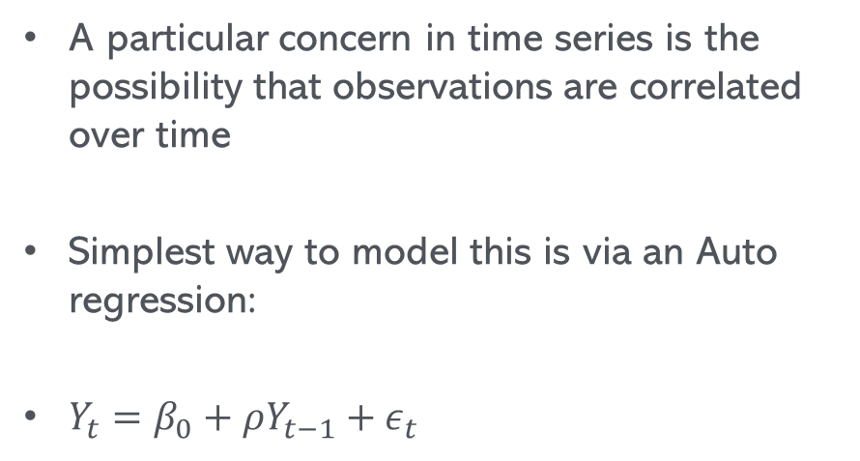

Autoregression
With $ρ=1$ we have non-stationarity because of path dependence
The series can wander off into any direction and neve come back
If that happens OLS is no longer un-biased (different observations are too related to each other)
Also: if you are interested in $Y=βX$ (i.e. the casual effect of X on Y) you get biased estimates
Random Walk
Of course we don’t know if this is the case in our data before we start any analysis
A particular concern in time series is the possibility that observations are correlated over time
Simplest way to model this is via an Auto regression:
$Y_{t}=β_{0}+ρY_{t−1}+ε_{t}$
$Y_{t−1}$ becomes the X variable
We can do normal OLS as long as $−1<ρ<1$
Need to test $\hat{ρ}=1$ but cannot use simple t or F test because under H0 it would be biased

Slide 11
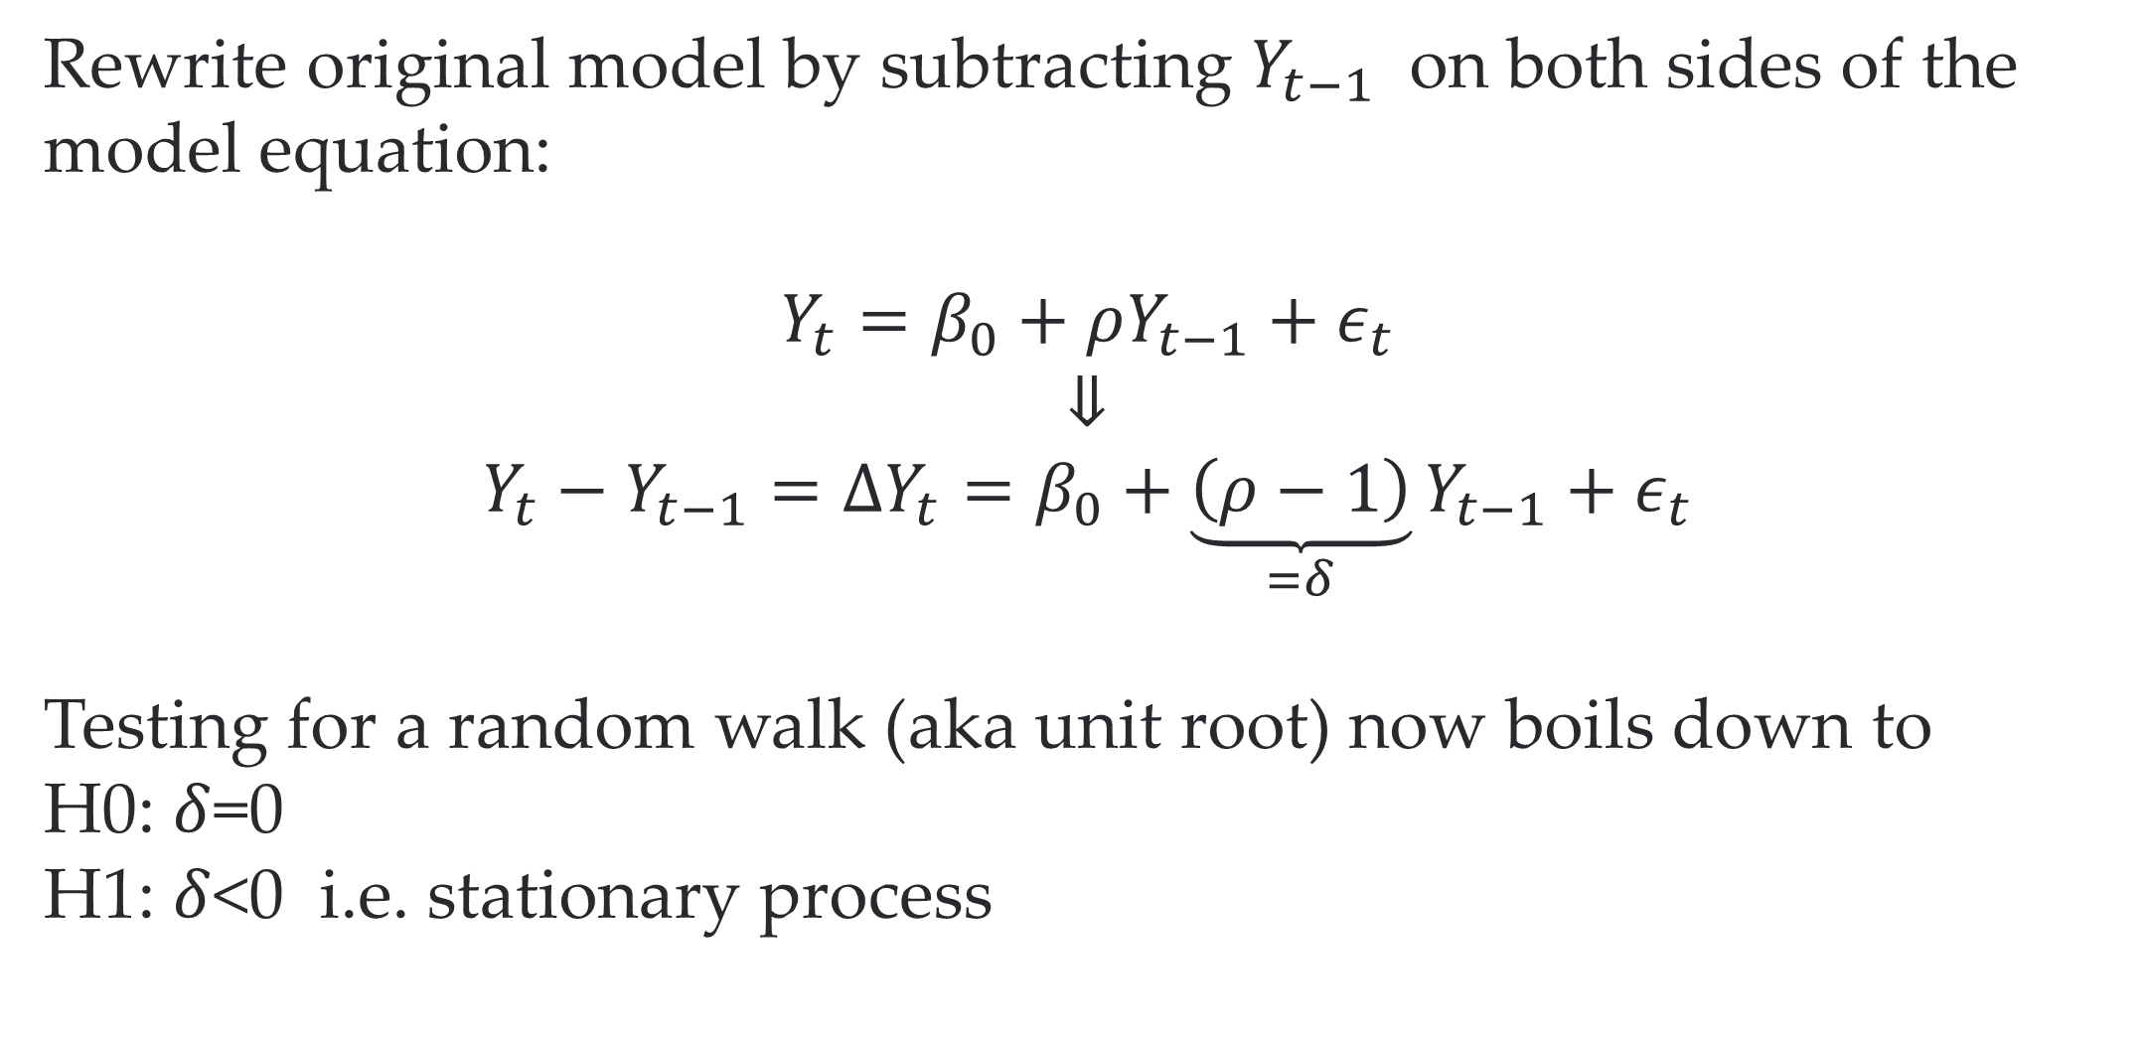
Dickey-Fuller test to the rescue
Rewrite original model by subtracting $Y_{t−1}$ on both sides of the model equation:
$$Y_{t}=β_{0}+ρY_{t−1}+ε_{t}$$
⇓
$$Y_{t}−Y_{t−1}=ΔY_{t}=β_{0}+\underset{=δ}{\underbrace{\left(ρ−1\right)}}Y_{t−1}+ε_{t}$$
Testing for a random walk (aka unit root) now boils down to
H0: $δ$=0
H1: $δ$<0 i.e. stationary process
We cannot just compare the implied test statistic to a normal t-table
Luckily R will help us

Slide 12
R to the rrrrrescue
library(urca) ur.df(df$lnindex) %>% summary()
## ## ############################################### ## # Augmented Dickey-Fuller Test Unit Root Test # ## ############################################### ## ## Test regression none ## ## ## Call: ## lm(formula = z.diff ~ z.lag.1 - 1 + z.diff.lag) ## ## Residuals: ## Min 1Q Median 3Q Max ## -8.343e-04 -2.643e-05 4.240e-06 4.131e-05 1.922e-04 ## ## Coefficients: ## Estimate Std. Error t value Pr(>|t|) ## z.lag.1 -2.155e-05 2.703e-05 -0.797 0.426 ## z.diff.lag 9.924e-01 5.596e-03 177.334 <2e-16 *** ## --- ## Signif. codes: 0 '***' 0.001 '**' 0.01 '*' 0.05 '.' 0.1 ' ' 1 ## ## Residual standard error: 7.414e-05 on 667 degrees of freedom ## Multiple R-squared: 0.9812, Adjusted R-squared: 0.9811 ## F-statistic: 1.739e+04 on 2 and 667 DF, p-value: < 2.2e-16 ## ## ## Value of test-statistic is: -0.7971 ## ## Critical values for test statistics: ## 1pct 5pct 10pct ## tau1 -2.58 -1.95 -1.62
We cannot reject unit root because -0.7971>-1.95

Slide 13
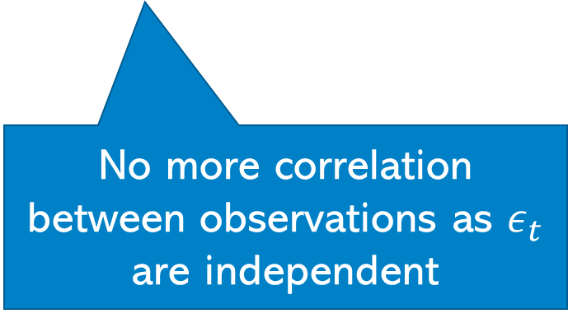
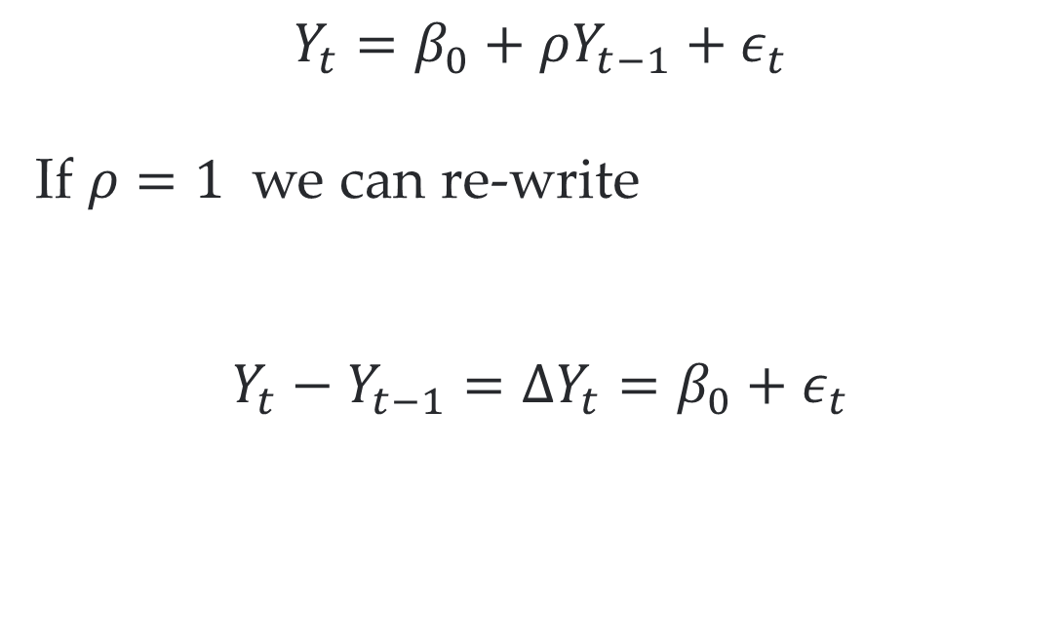
Getting rid of unit roots
$$Y_{t}=β_{0}+ρY_{t−1}+ε_{t}$$
If $ρ=1$ we can re-write
$$Y_{t}−Y_{t−1}=ΔY_{t}=β_{0}+ε_{t}$$
No more correlation between observations as $ε_{t}$ are independent

Slide 14
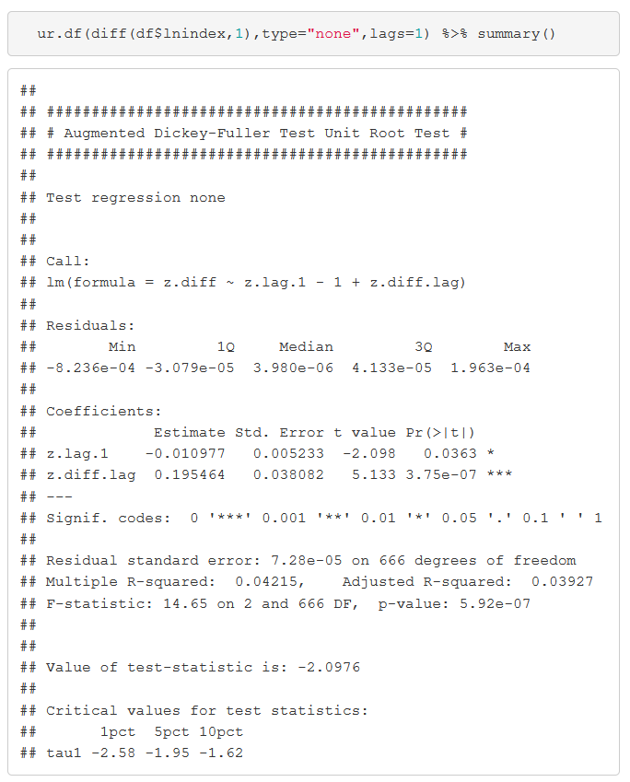
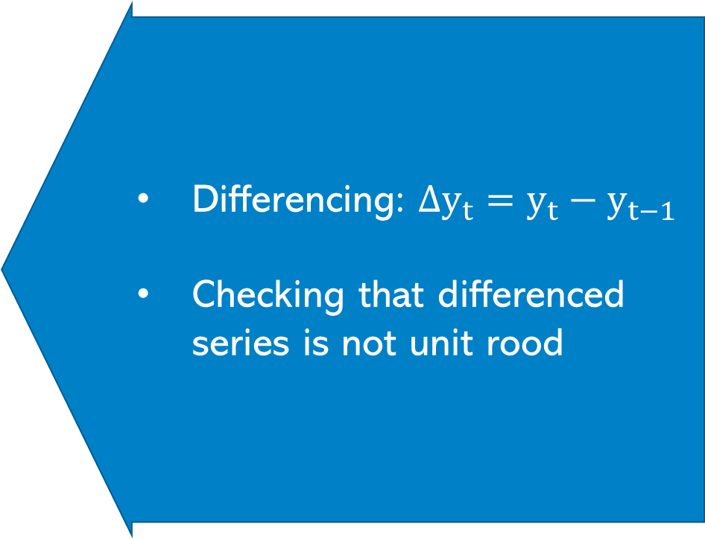
Getting rid of unit roots in practice – Economic Activity index
Differencing: $Δy_{t}=y_{t}−y_{t−1}$
Checking that differenced series is not unit rood
We can reject unit root (at least at 5%)

Slide 15
Revisiting COVID vs GDP
df=df %>% arrange(week) %>% mutate( Dlnindex=lnindex - dplyr::lag(lnindex) ,Llnindex=dplyr::lag(lnindex) ) lm(Dlnindex~cases+t,df) %>% summary()
## ## Call: ## lm(formula = Dlnindex ~ cases + t, data = df) ## ## Residuals: ## Min 1Q Median 3Q Max ## -2.175e-03 -6.473e-05 7.992e-05 1.627e-04 1.327e-03 ## ## Coefficients: ## Estimate Std. Error t value Pr(>|t|) ## (Intercept) 1.729e-04 3.019e-05 5.726 1.55e-08 *** ## cases -9.290e-04 4.573e-05 -20.314 < 2e-16 *** ## t 3.831e-07 8.113e-08 4.723 2.84e-06 *** ## --- ## Signif. codes: 0 '***' 0.001 '**' 0.01 '*' 0.05 '.' 0.1 ' ' 1 ## ## Residual standard error: 0.0003811 on 667 degrees of freedom ## (1 observation deleted due to missingness) ## Multiple R-squared: 0.3856, Adjusted R-squared: 0.3838 ## F-statistic: 209.3 on 2 and 667 DF, p-value: < 2.2e-16
100k more cases = 0. 0929% lower GDP…

Slide 16
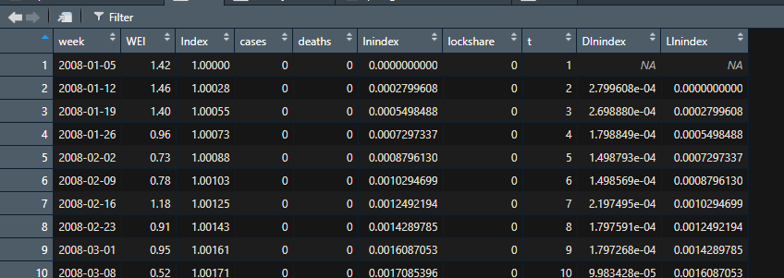
Lagging
df=df %>% arrange(week) %>% mutate( Dlnindex=lnindex - dplyr::lag(lnindex) ,Llnindex=dplyr::lag(lnindex) ) lm(Dlnindex~cases+t,df) %>% summary()
## ## Call: ## lm(formula = Dlnindex ~ cases + t, data = df) ## ## Residuals: ## Min 1Q Median 3Q Max ## -2.175e-03 -6.473e-05 7.992e-05 1.627e-04 1.327e-03 ## ## Coefficients: ## Estimate Std. Error t value Pr(>|t|) ## (Intercept) 1.729e-04 3.019e-05 5.726 1.55e-08 *** ## cases -9.290e-04 4.573e-05 -20.314 < 2e-16 *** ## t 3.831e-07 8.113e-08 4.723 2.84e-06 *** ## --- ## Signif. codes: 0 '***' 0.001 '**' 0.01 '*' 0.05 '.' 0.1 ' ' 1 ## ## Residual standard error: 0.0003811 on 667 degrees of freedom ## (1 observation deleted due to missingness) ## Multiple R-squared: 0.3856, Adjusted R-squared: 0.3838 ## F-statistic: 209.3 on 2 and 667 DF, p-value: < 2.2e-16
Note how to create lagged values: use the dplyr::lag() function

Slide 17
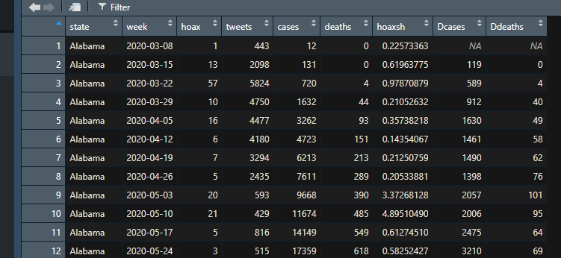
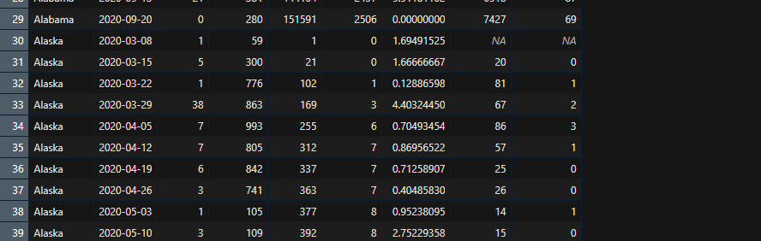
Lagging with panel data
statsbyweek = statsbyweek %>%
arrange(state,week) %>%
group_by(state) %>%
mutate(Dcases=cases-dplyr::lag(cases,1), Ddeaths=deaths-dplyr::lag(deaths,1))

Slide 18
Summary
Time series can be easy
But you need to worry about how stationary your series is
If the series clearly grows or shrinks continuously definitely include a time trend
However, even if it doesn’t grow (or shrink) the series might contain a unit root
If that’s the case a time trend is not enough
Use the Dickey Fuller Test to make sure you are dealing with a stationary series
If not take first difference and check Dickey Fuller again
Reliable causal estimators you can only get from a stationary series.
If you have panel data you can control for specific time effects (and cross sectional unit effects)

Slide 19

Extra Slides

Slide 20
Other considerations
lm(Dlnindex~cases+lockshare+t,df) %>% summary()
## ## Call: ## lm(formula = Dlnindex ~ cases + lockshare + t, data = df) ## ## Residuals: ## Min 1Q Median 3Q Max ## -9.141e-04 -1.092e-04 2.947e-05 1.456e-04 1.104e-03 ## ## Coefficients: ## Estimate Std. Error t value Pr(>|t|) ## (Intercept) 1.209e-04 2.266e-05 5.335 1.31e-07 *** ## cases 5.646e-04 7.334e-05 7.698 5.00e-14 *** ## lockshare -2.772e-05 1.205e-06 -23.014 < 2e-16 *** ## t 6.278e-07 6.152e-08 10.205 < 2e-16 *** ## --- ## Signif. codes: 0 '***' 0.001 '**' 0.01 '*' 0.05 '.' 0.1 ' ' 1 ## ## Residual standard error: 0.0002847 on 666 degrees of freedom ## (1 observation deleted due to missingness) ## Multiple R-squared: 0.6578, Adjusted R-squared: 0.6562 ## F-statistic: 426.7 on 3 and 666 DF, p-value: < 2.2e-16
lockshare=percentage of population in lockdown
If 100% of US population go into lockdown GDP goes down by -0.2772% (seems low..more research needed)

Slide 21

More lags AR(2)?
$$Y_{t}−Y_{t−1}=β_{0}+\left(β_{1}+β_{2}−1\right)Y_{t−1}−β_{2}\left(Y_{t−1}−Y_{t−2}\right)+ε_{t}$$
We can test this again using the coefficient on $Y_{t−1}$
More lags and trend?
$$Y_{t}−Y_{t−1}=β_{0}+\left(β_{1}+β_{2}−1\right)Y_{t−1}−β_{2}\left(Y_{t−1}−Y_{t−2}\right)+ρt+ε_{t}$$

Slide 22


Further reading
On time fixed effects: Hanck et al Chapter 10.4
Unit roots: Hanck et al Chapter 14.7

